Slide 1
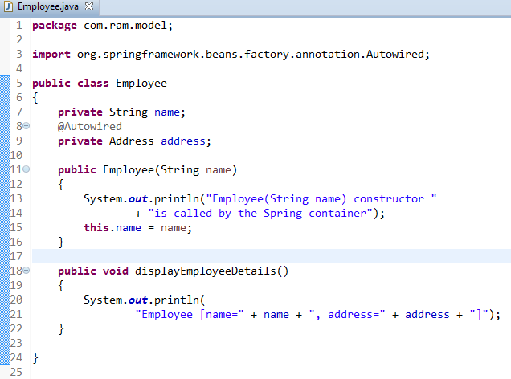

Spring Auto-Wiring Beans with @Autowired annotation
The @Autowired annotation is auto wire the bean by matching data type.
We can use @Autowired annotation to auto wire bean on the setter method, constructor or a field. Moreover, it can autowired property in a particular bean.

Slide 2
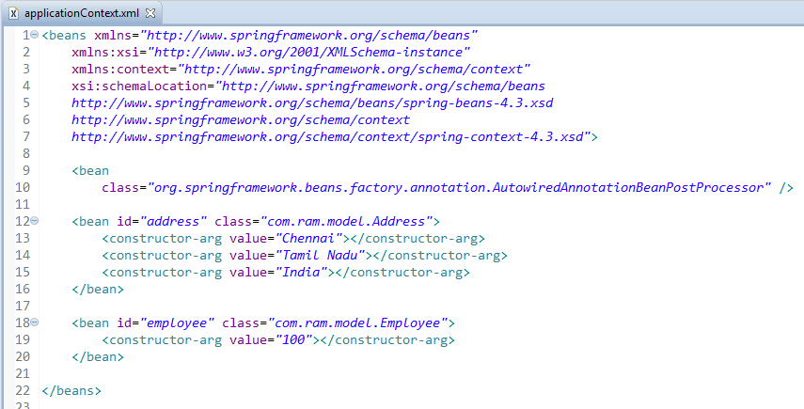
Spring Auto-Wiring Beans with @Autowired annotation
To enable @Autowired, you have to register ‘AutowiredAnnotationBeanPostProcessor‘, and you can do it in two ways.
Include <context:annotation-config />
Include AutowiredAnnotationBeanPostProcessor

Slide 3
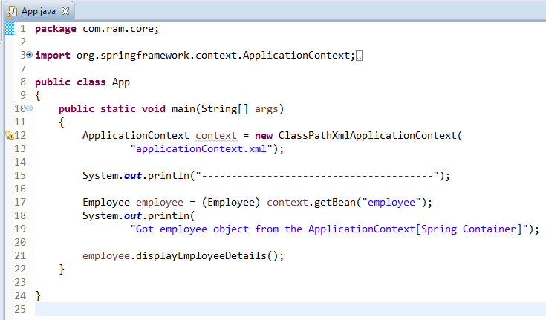
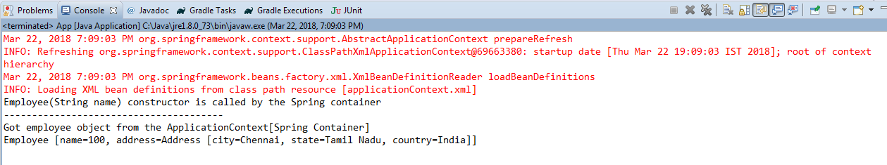
Spring Auto-Wiring Beans with @Autowired annotation

